Slide 1

Computer System Servicing

Slide 2
Computer
A computer is an electronic device that has the capability to manipulate information or data store, retrieve, and process it for more useful information. It is programmable so it can responds to specific instruction or command.

Slide 3
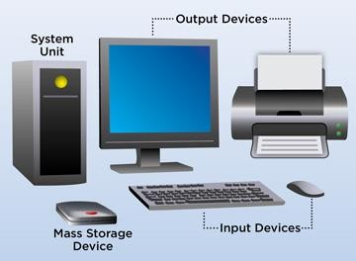
Computer System
A computer system is a set of integrated devices that input, output, process, and store data and information.

Slide 4
Types of Computer by Purpose
Micro Computer - a small computer that contains a microprocessor as its central processor.
Mini Computer - a computer of medium power, more than a microcomputer but less than a mainframe.
Mainframe - is a computer used primarily by large organizations for critical applications, bulk data processing and large-scale transaction processing.
Super Computer -a particularly powerful mainframe computer

Slide 5
Types of Computer by Function
Server - is a piece of computer hardware or software (computer program) that provides functionality for other programs or devices, called "clients".
Work Station - a high-performance computer system that is basically designed for a single user and has advanced graphics capabilities, large storage capacity, and a powerful microprocessor (central processing unit).

Slide 6
Types of Computer by Function
Information Appliances - is an appliance that is designed to easily perform a specific electronic function such as playing music, photography, or editing text.
Embedded Computer - An embedded system is a microprocessor-based computer hardware system with software that is designed to perform a dedicated function, either as an independent system or as a part of a large system.

Slide 7
Types of Computer by Usage
Public Computer - is any of various computers available in public areas.
Personal Computer - are intended to be operated directly by an end user, rather than by a computer expert or technician.

Slide 8
Types of Computer by Usage
Shared Computer - is a computer resource made available from one host to other hosts on a computer network.
Display Computer - A display is a computer output surface and projecting mechanism that shows text and often graphic images to the computer user, using a cathode ray tube ( CRT ), liquid crystal display ( LCD ), light-emitting diode, gas plasma, or other image projection technology.

Slide 9
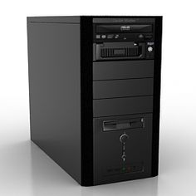
Common Parts of Desktop Computer
System Unit - is the main body of a desktop computer which is typically consisting of a metal or plastic enclosure containing all the essential parts of the personal computer.

Slide 10
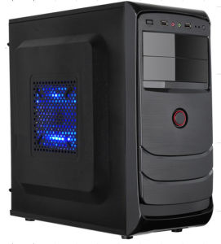
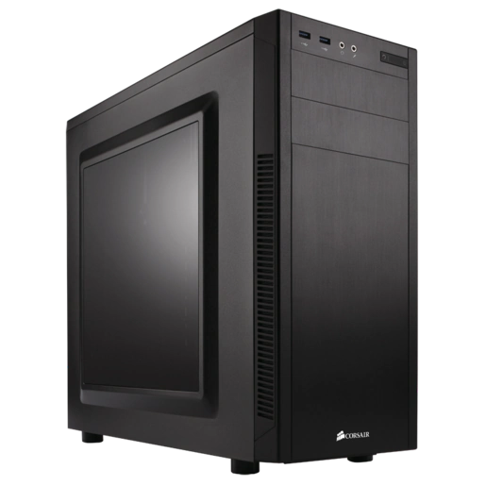
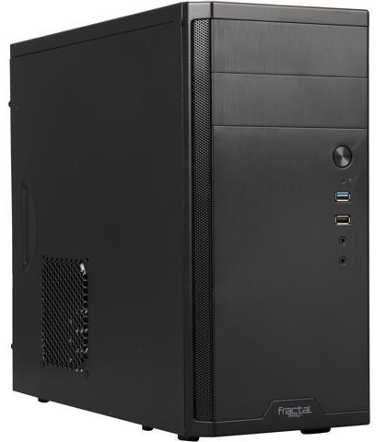
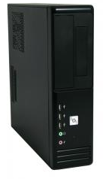
Form Factor of System Unit
Full Tower
Mid Tower
Mini Tower
Slim Line Case

Slide 11
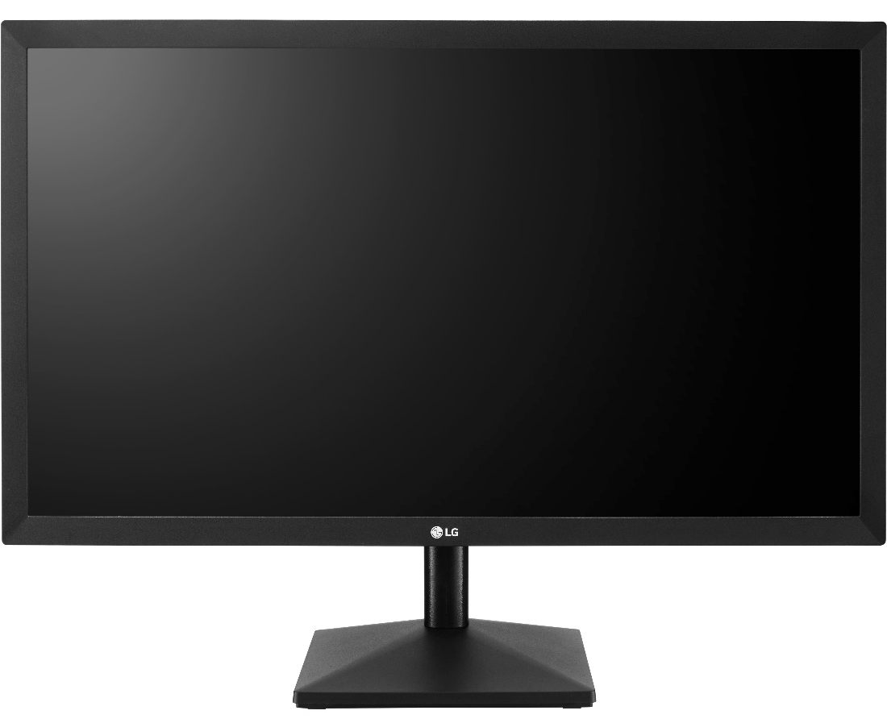
Common Parts of Desktop Computer
Monitor- is a visual display unit, which shows images generated from the video adapter of a computer.

Slide 12
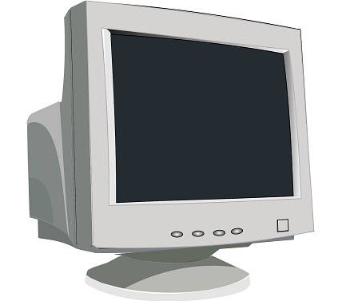
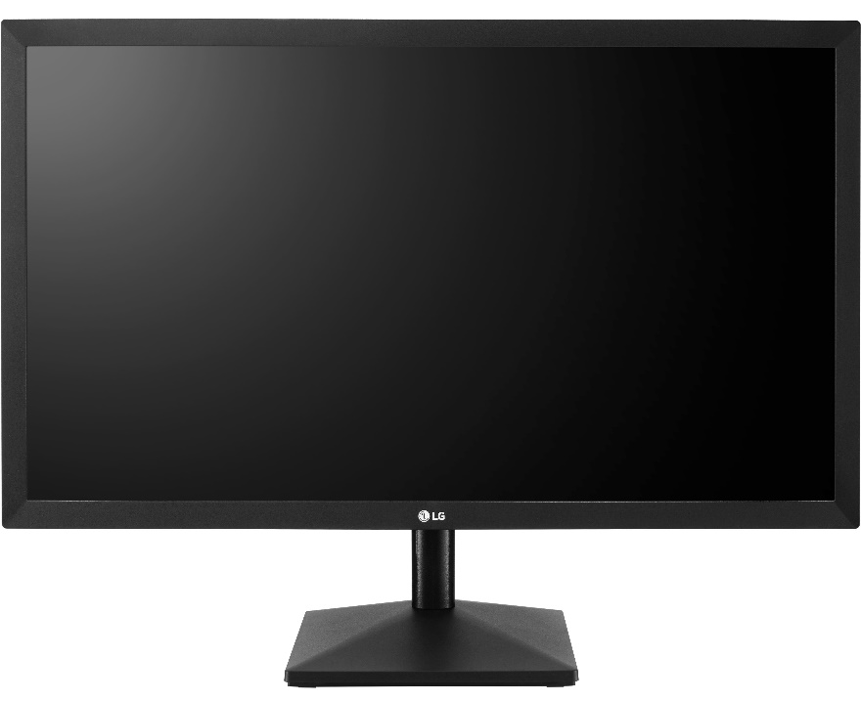
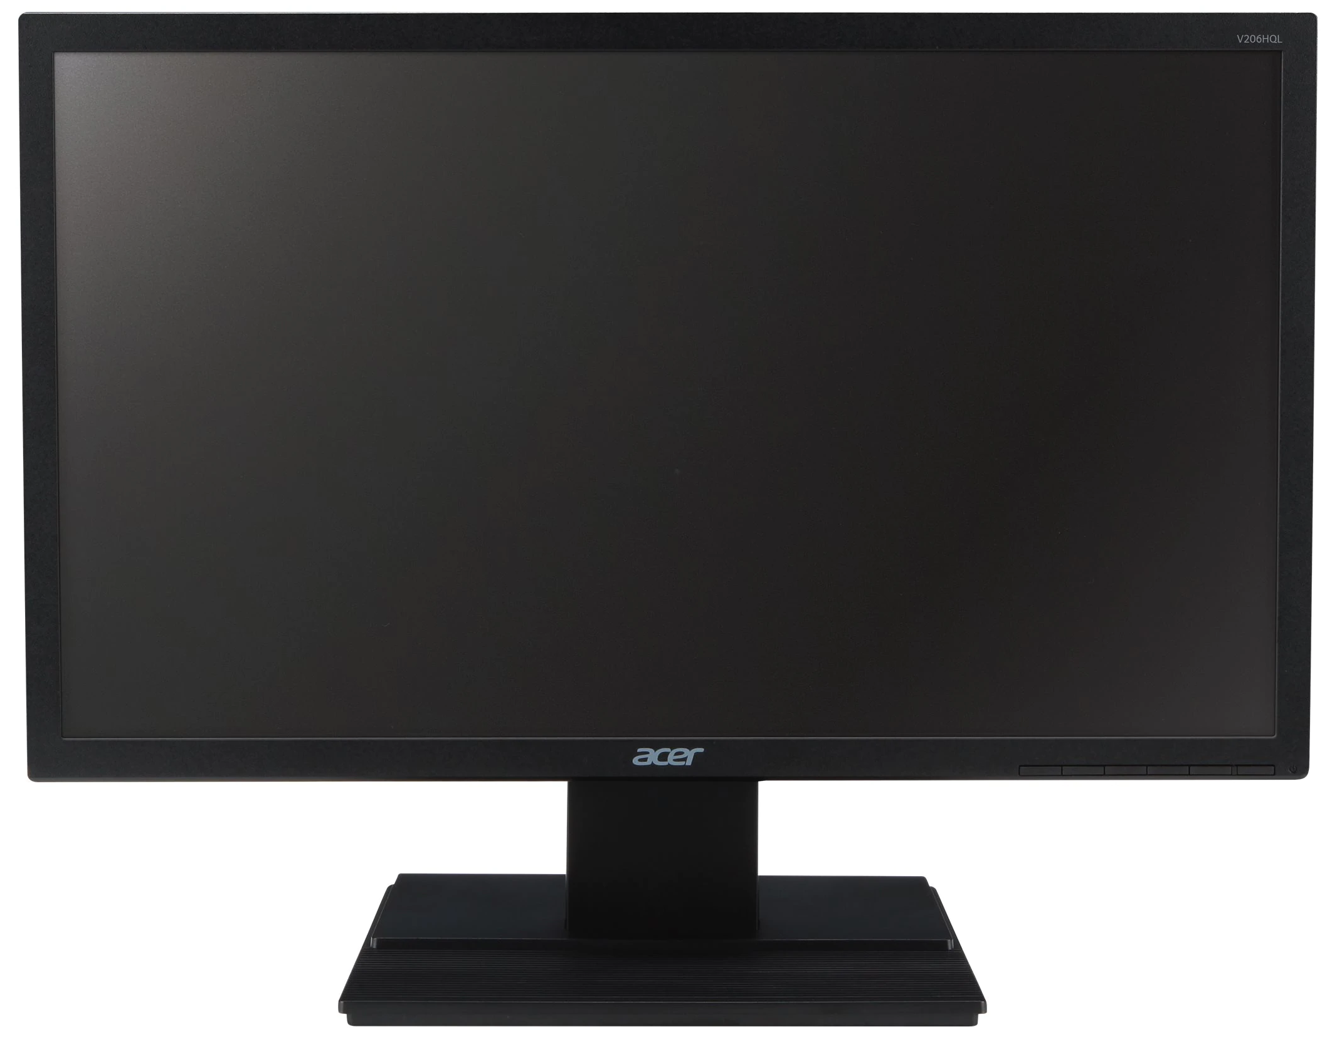
Types of Monitor
CRT
LCD
LED

Slide 13
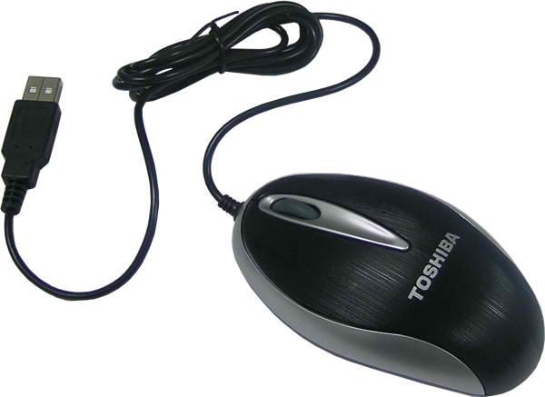
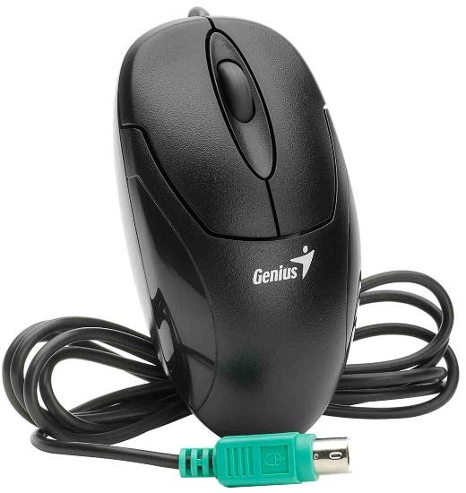
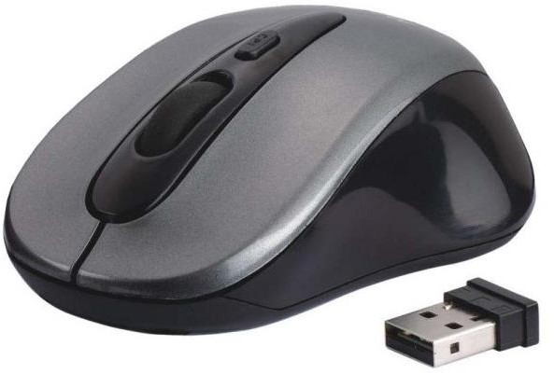
Common Parts of Desktop Computer
Optical USB Mouse
PS/2 Mouse
Mouse - is also known as pointing device whose function is to detect two-dimensional motion relative to its supporting surface.
Wireless Mouse

Slide 14
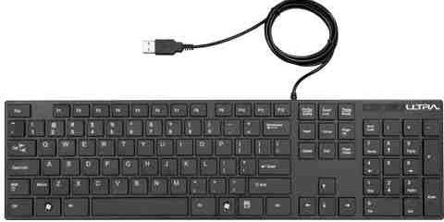
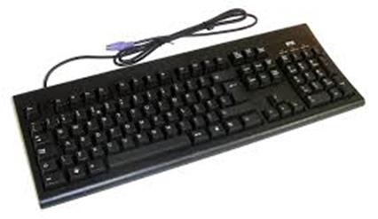
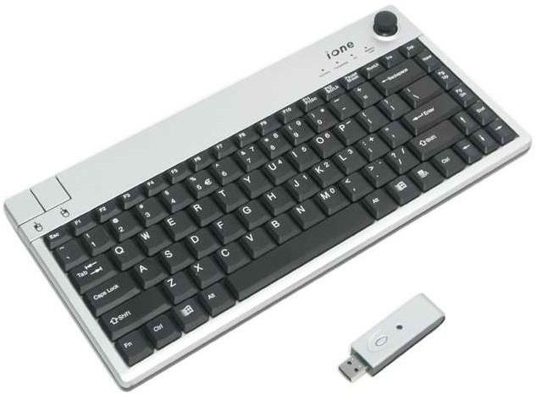
Common Parts of Desktop Computer
Optical USB Keyboard
PS/2 Keyboard
Keyboard - is an input device, designed just like a typewriter keyboard. It is one of the primary ways we communicate with the computer and enter data.
USB Keyboard
Wireless Keyboard

Slide 15
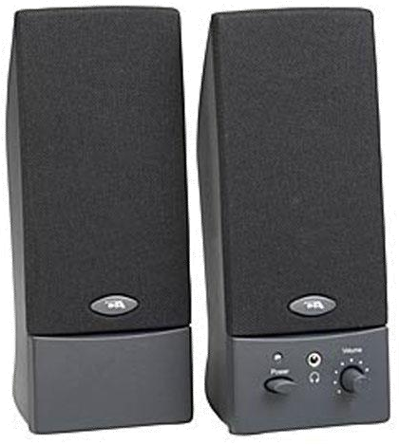
Common Parts of Desktop Computer
Speaker - are external audio device which is commonly equipped with a low-power internal amplifier.

Slide 16
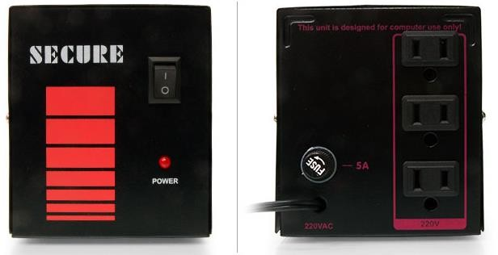
Common Parts of Desktop Computer
AVR – Regulates the flow of current in your computer.

Slide 17
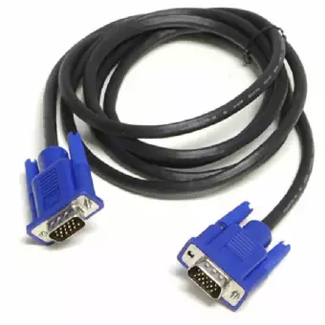
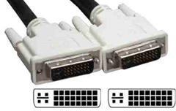
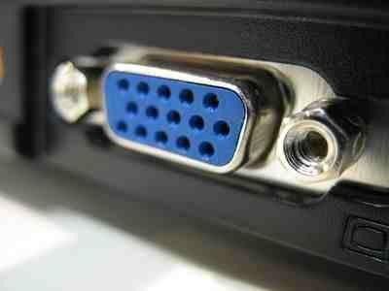
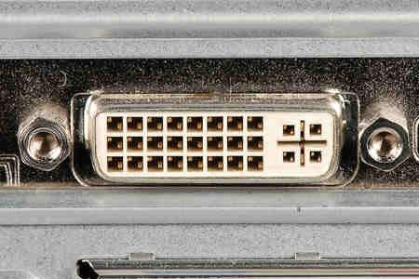
Cable/Connectors and Ports
VGA Cable
VGA Port
DVI Connector
DVI Port

Slide 18
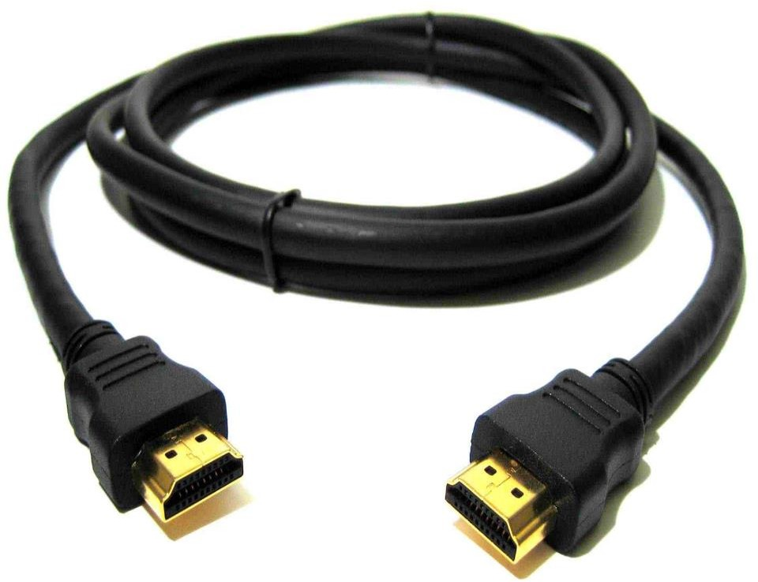
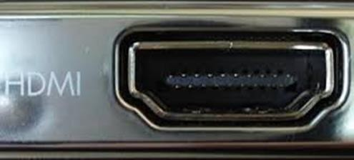
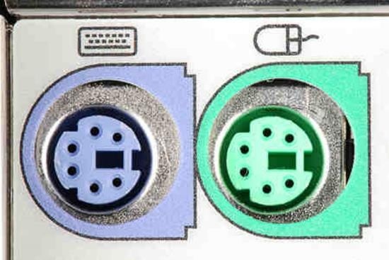
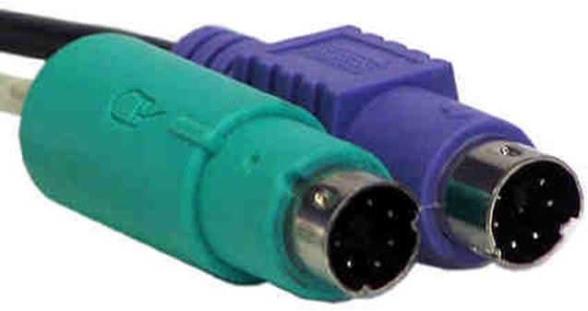
Cable/Connectors and Ports
HDMI Cable
HDMI Port
PS/2 Connector
PS/2 Port

Slide 19
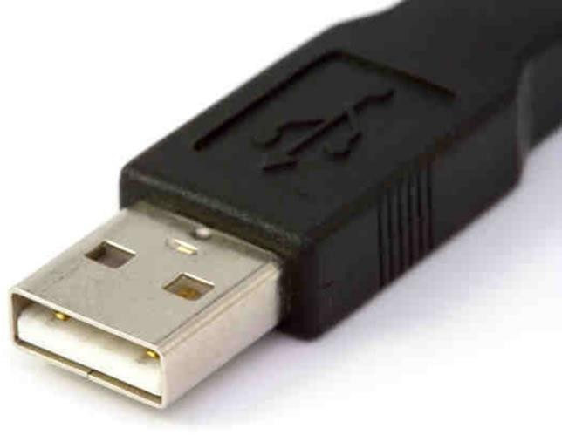
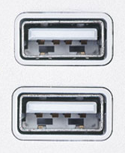
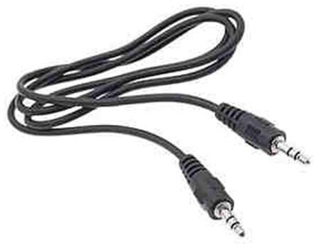
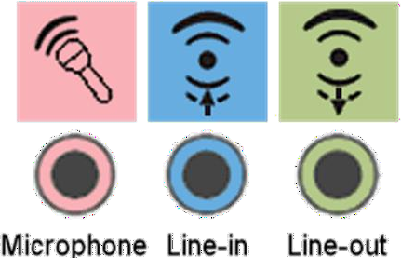
Cable/Connectors and Ports
USB Connector
USB Port
Speaker Connector
Audio Port

Slide 20
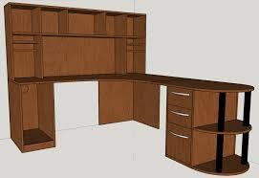
Setting up Computer Desktop
1. Be sure to place your computer case in an area that is well-ventilated and that has good air flow. This will help to prevent overheating.

Slide 21
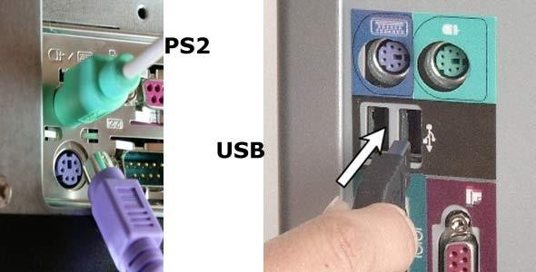
Setting up Computer Desktop
2. Connect the PS/2 or USB Mouse and Keyboard’s connector to its designated port.

Slide 22
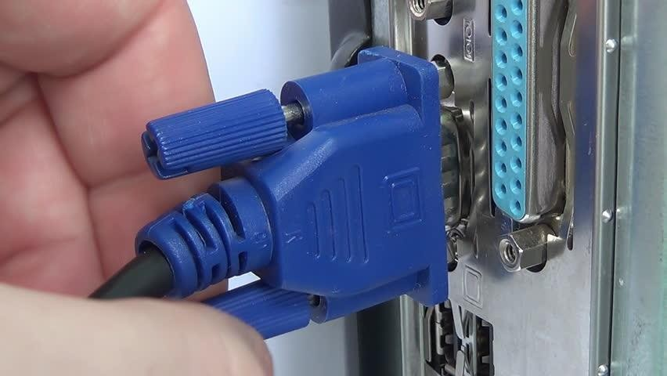
Setting up Computer Desktop
3. Connect the VGA Adaptor/connector to the Video Card.

Slide 23
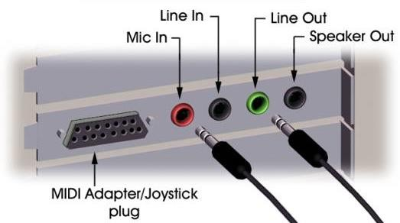
Setting up Computer Desktop
4. Connect the Audio port to the Sound Card located at the Back Panel of your System Unit.

Slide 24
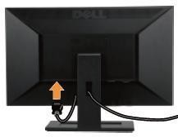
Setting up Computer Desktop
5. Connect the Power Cord at back of the Computer Monitor.

Slide 25
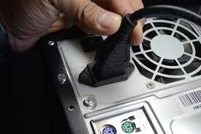
Setting up Computer Desktop
6. Connect the Power Cord to the Power Supply Unit located at the Back Panel of the System Unit.

Slide 26
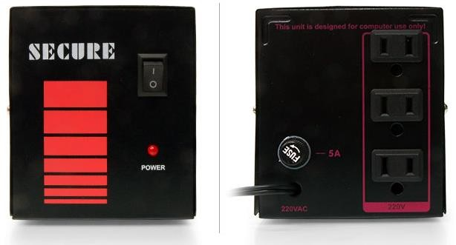
Setting up Computer Desktop
7. Connect the Monitor’s Power Cord and the PSU ‘s Power Cord to your Automatic Voltage Regulator.

Slide 27
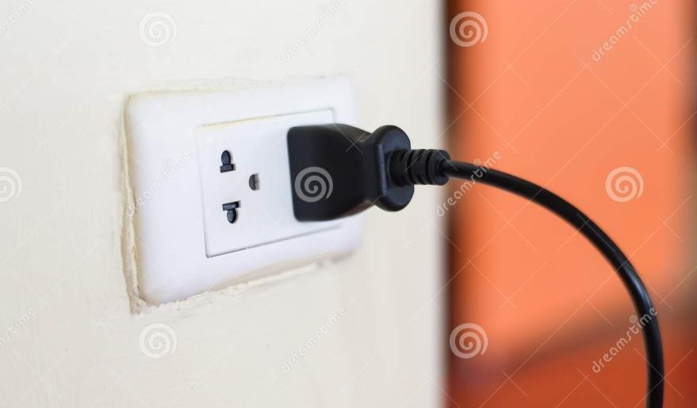
Setting up Computer Desktop
8. Connect the AVR‘s Power Cord to the Power Outlet.

Slide 28
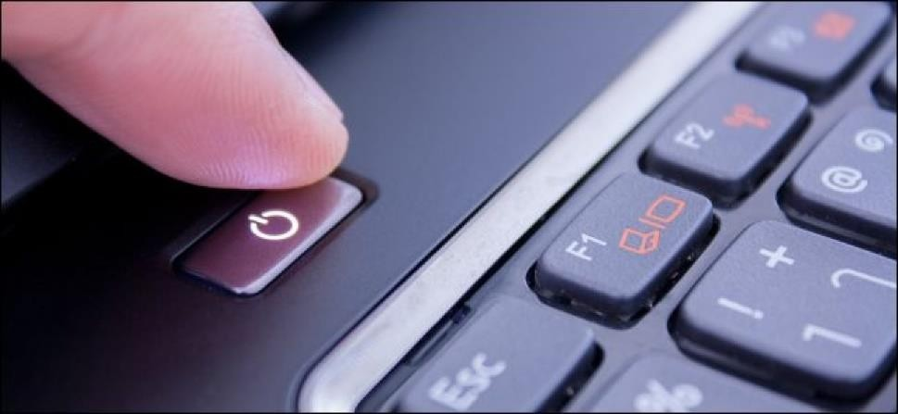
Setting up Computer Desktop
9. Turn ON the Computer.

